Slide 1


Importance of mental health
Joy Pal
Id: 201002418
Dept. of Computer Science and Engineering
Green University

Slide 2

Contents
Mental Health
Signs of Mental illness
Causes of Mental illness
Treatment & Recovery
Maintain Mental Health
Conclusion

Slide 3

Mental Health
It’s mean Keeping mind healthy
Mental health is the State of psychological well-being or mental illness is absent.
Schizophrenia, Anxiety and Panic disorder, Eating disorder, BBD, BPD, Trauma etc.

Slide 4
Signs of Mental illness
Feeling sad or down
Confused thinking or reduced ability to concentrate
Excessive fears or worries, or extreme feelings of guilt
Extreme mood changes of highs and lows
Withdrawal from friends and activities
Significant tiredness, low energy or problems sleeping Etc.

Slide 5
Causes of Mental illness
Childhood abuse, trauma or neglect
Social isolation or loneliness
Unemployment
Homelessness or poor housing
Long-term stress
Losing someone close to you
Drug and alcohol misuse

Slide 6
Treatment and Recovery
Medications
Psychotherapy
Brain-simulation treatments
Participating in your own care
Recovery is about building a meaningful and satisfying life
Recovery means gaining and retaining hope, developing an understanding of one’s abilities and disabilities

Slide 7
How to Maintain Mental Health
Spend time with friends, loved ones and people you trust
Talk about or express your feelings regularly
Avoid drug
Develop new skills
Relax and enjoy your hobbies
Set realistic goals
Get enough sleep
Keep active and eat well

Slide 8
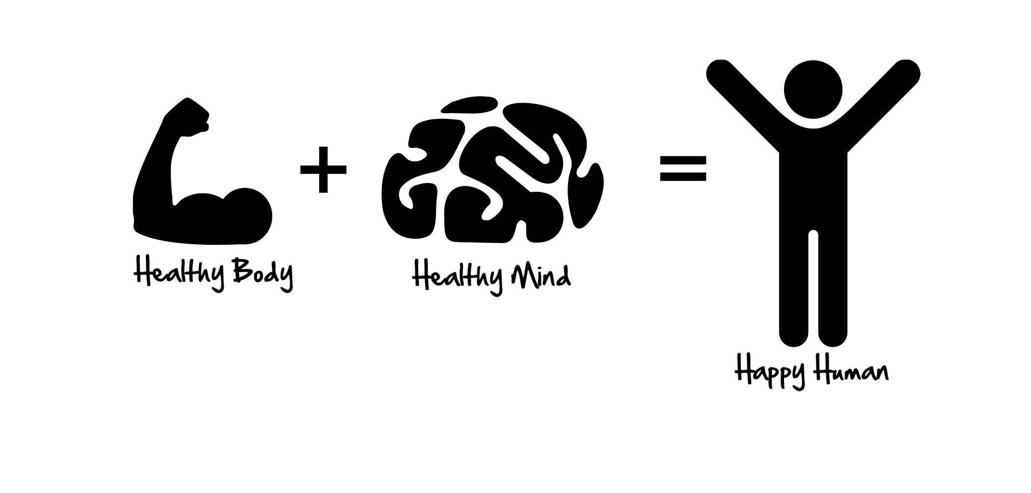
Conclusion
Mental illnesses are medical conditions that deserve the same respect, consideration and right to treatment as any other illness.
Mental and physical health cannot be separated from each other.

Slide 9

Any Query ?

Slide 10


